Slide 1


Alawi Mohammed Nuru
June 10 2025

Slide 2

Outline
Executive Summary
Introduction
Methodology
Results
Conclusion
Appendix

Slide 3
Executive Summary
Summary of methodologies
Data collection
Data Wrangling
EDA( Exploratory Data Analysis)
Interactive Visual Analysis
Predictive Analysis
Summary of all results
Best performing Model: Support Vector Machine achieved highest accuracy in predicting launch success.
Certain launch sites showed showed higher success rate that others.
Dashboard provide intuitive interfaced for stakeholders to explore dynamically

Slide 4
Introduction
Project background and context
This capstone project uses data science techniques to analyze SpaceX Falcon 9 launch records, aiming to discover what influences mission success and how to predict it.
Problems you want to find answers
Which launch sites have the highest success rates?
How does payload mass affect launch outcomes?
Can we predict the outcome of a future launch using machine learning?
What geographical factors might influence launch site performance?

Slide 5

Section 1

Slide 6
Methodology
Executive Summary
Data collection methodology:
Describe how data was collected
sourced launch data from SpaceX and payload datasets via the IBM Cloud Object Storage.
Perform data wrangling
Describe how data was processed
cleaned and merged datasets, converted date formats, and engineered features such as payload mass and orbit types.
Perform exploratory data analysis (EDA) using visualization and SQL
Perform interactive visual analytics using Folium and Plotly Dash
Perform predictive analysis using classification models
How to build, tune, evaluate classification models

Slide 7
Data Collection
Describe how data sets were collected.
You need to present your data collection process use key phrases and flowcharts
obtained historical launch data for SpaceX Falcon 9 missions using a combination of APIs and web scraping from credible sources
┌────────────┐ ┌─────────────┐ ┌────────────┐
│ SpaceX API │ ──▶ │ Web Scraping│ ──▶ │ Raw Dataset │
└────────────┘ └─────────────┘ └────────────┘
▼ ▼
JSON format data HTML launch tables
▼ ▼
Data Cleaning & Structuring (Pandas)
▼
Cleaned CSV File

Slide 8
Data Collection – SpaceX API
Start
↓
Request data from SpaceX API (https://api.spacexdata.com/v4/launches)
↓
Receive JSON response
↓
Normalize JSON using pandas.json_normalize()
↓
Extract relevant fields
(e.g., launch site, payload mass, class)
↓
Store in DataFrame
↓
Proceed to wrangling & analysis
Present your data collection with SpaceX REST calls using key phrases and flowcharts
Add the GitHub URL of the completed SpaceX API calls notebook (must include completed code cell and outcome cell), as an external reference and peer-review purpose
GitHub URL Applied-Data-Science-Capstone/jupyter-labs-spacex-data-collection-api.ipynb at main · nurualawi/Applied-Data-Science-Capstone

Slide 9
Data Collection - Scraping
Start
↓
Send HTTP request to target website
↓
Receive HTML content
↓
Parse HTML using BeautifulSoup
↓
Locate relevant data elements
(e.g., booster version, launch details)
↓
Extract and clean data
↓
Convert data into pandas DataFrame
↓
Save or merge with other datasets
Present your web scraping process using key phrases and flowcharts
Add the GitHub URL of the completed web scraping notebook, as an external reference and peer-review purpose
GitHub URL Applied-Data-Science-Capstone/jupyter-labs-webscraping (2).ipynb at main · nurualawi/Applied-Data-Science-Capstone

Slide 10
Data Wrangling
Start
↓
Load raw datasets (API, web scraping, CSV)
↓
Explore structure, check for nulls & inconsistencies
↓
Clean data: remove nulls, standardize formats
↓
Merge datasets on launch ID or similar keys
↓
Create new columns/features for analysis
↓
Output: Clean, structured DataFrame
GitHub URL Applied-Data-Science-Capstone/labs-jupyter-spacex-Data wrangling.ipynb at main · nurualawi/Applied-Data-Science-Capstone

Slide 11
EDA with Data Visualization
Bar Chart (Success Count by Launch Site)
Pie Chart (Success Rate Distribution)
Scatter Plot (Payload vs. Success)
Histogram (Payload Distribution)
Line Plot (Launch Outcomes Over Time)
GitHub URL Applied-Data-Science-Capstone/edadataviz.ipynb at main · nurualawi/Applied-Data-Science-Capstone

Slide 12
.
EDA with SQL
Selected all records from SpaceX dataset for full view of data.
Queried launch success rates by site to compare performance.
Counted number of launches per Booster Version Category.
Retrieved records with payload mass above 5000 kg to assess heavy launches.
Filtered launches where landing outcome = success for model training.
Grouped data by Orbit and calculated average success rate.
Applied-Data-Science-Capstone/jupyter-labs-eda-sql-coursera_sqllite.ipynb at main · nurualawi/Applied-Data-Science-Capstone

Slide 13
Build an Interactive Map with Folium
Markers: Placed at each launch site to pinpoint exact SpaceX locations and Enabled pop-ups displaying site names
Circles: Represented launch site zones with customizable radius and to to visually differentiate proximity or risk areas
Lines: Connected launch sites to nearest cities or landmarks and to visualize range and logistics of launch operations.
MarkerCluster: Grouped closely located launches to prevent clutter on zoomed-out maps and Enhanced interactivity and readability of dens

Slide 14
Build an Interactive Map with Folium
Why these objects were added:
✔ To visualize spatial relationships among launch sites.
✔ To enhance user interaction and understanding of geospatial data.
✔ To support analysis of location impact on launch success.
Applied-Data-Science-Capstone/lab_jupyter_launch_site_location.ipynb at main · nurualawi/Applied-Data-Science-Capstone

Slide 15
Build a Dashboard with Plotly Dash
Pie Chart: Shows distribution of successful launches and Interactively updates based on selected launch site.
Helps identify which sites contribute most to total success.
Scatter Plot: Displays correlation between payload mass and launch success and Updates dynamically based on both site selection and payload range.
Dropdown Menu: Allows selection of specific launch sites or viewing all sites and Drives updates to both the pie and scatter plots
RangeSlider:
Enables user to filter scatter plot by payload mass range Adds deeper control to the analysis

Slide 16
Build a Dashboard with Plotly Dash
Why these plots and interactions were added:
✔ To enable exploratory analysis with real-time updates.
✔ To help users discover patterns in launch success data.
✔ To engage users through intuitive and interactive visualizations.
GitHub URL Applied-Data-Science-Capstone/spacex-dash-app.py at main · nurualawi/Applied-Data-Science-Capstone

Slide 17
Predictive Analysis (Classification)
Data Preparation: convert to numpy array, standardize and split data
Model Selection: Evaluated 4 models, Logistic Regression, Support Vector Machine (SVM), Decision Tree and K-Nearest Neighbors (KNN)
Model Tuning: used GridSearchCV with 10-fold cross-validation
Model Evaluation: used .score() method to compute accuracy on test data
Best Model Selection:
Selected model with highest test accuracy from GridSearchCV results.
Final model used for prediction and interpretation.

Slide 18
Predictive Analysis (Classification)
Data Cleaning → Standardization → Train/Test Split
↓
Model Selection (4 types)
↓
GridSearchCV Hyperparameter Tuning
↓
Model Evaluation & Confusion Matrix
↓
Best Model Selection Based on Accuracy
GitHub URL Applied-Data-Science-Capstone/SpaceX_Machine Learning Prediction_Part_5.ipynb at main · nurualawi/Applied-Data-Science-Capstone

Slide 19
Results
Exploratory Data Analysis (EDA) Results
Identified correlation between payload mass and success rate.
Found that launch success varies across sites, with some having higher success rates.
Observed that Falcon 9 booster version influences landing success.

Slide 20
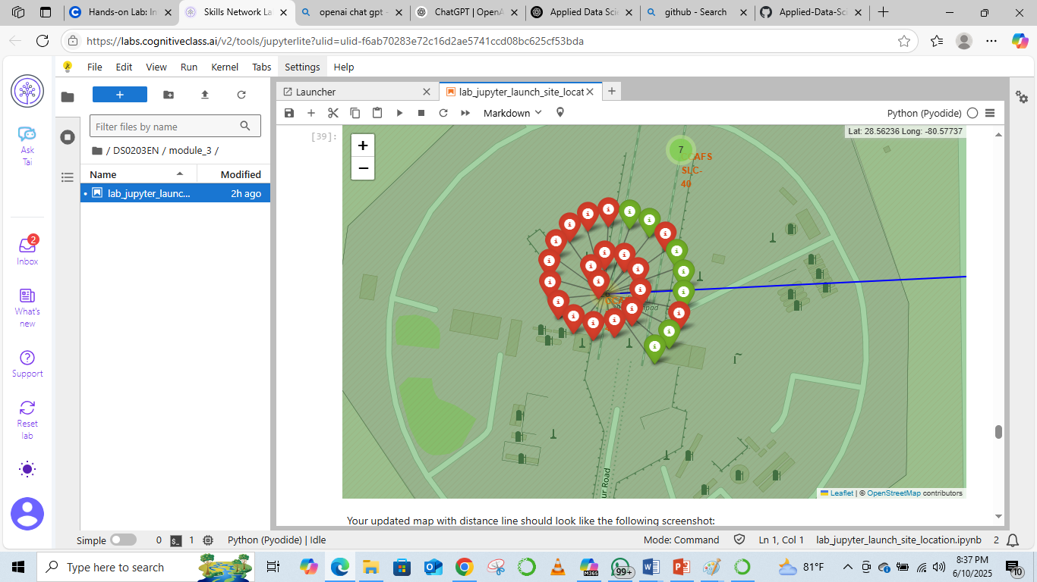
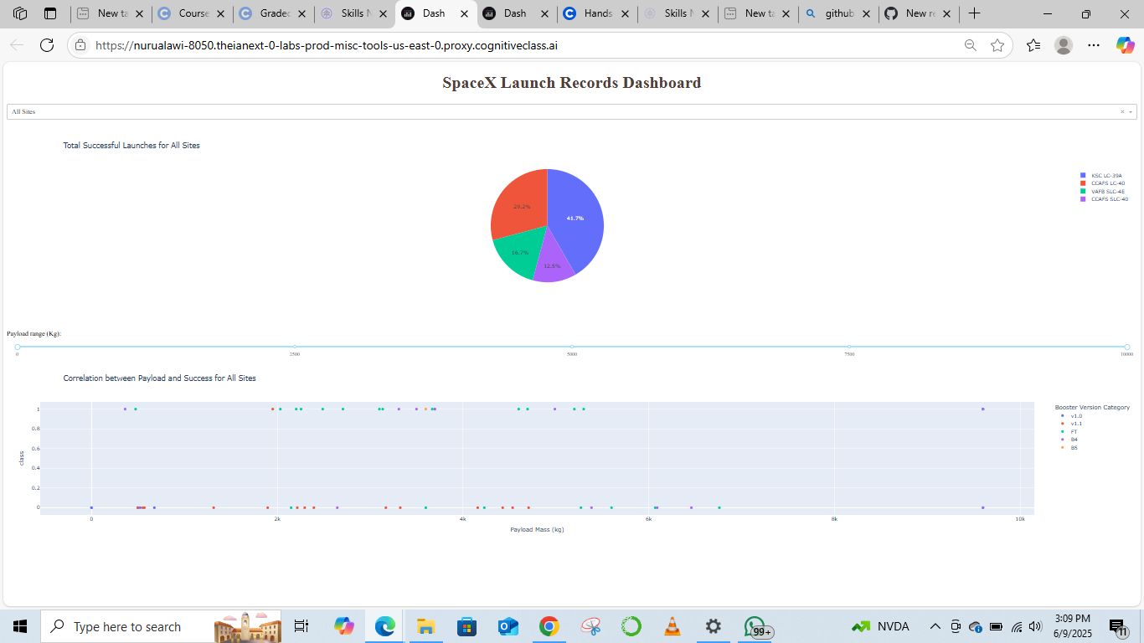
Interactive Analytics (Screenshots Demo)

Slide 21
Predictive Analysis Results
Best model: Achieved highest accuracy using Support Vector Machine (SVM).
Accuracy across models on test data:
Logistic Regression: 83%
SVM: 87%
Decision Tree: 78%
KNN: 80%

Slide 22

Section 2

Slide 23
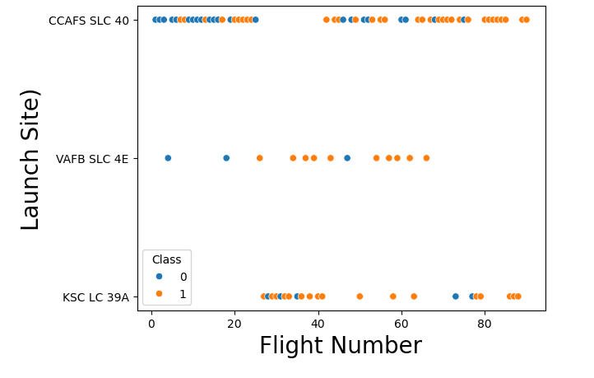
Flight Number vs. Launch Site
This plot shows how launch activity is distributed over time across different launch sites.
Each point represents a SpaceX launch attempt
Class 1(orange) means successful landing class 0 (blue) means Unsucessful landing
CCAFA SCL 40 site had the most attempted and also successful landings
Generally all three sites had a higher success rate in the later attempts compared to initial attempts

Slide 25
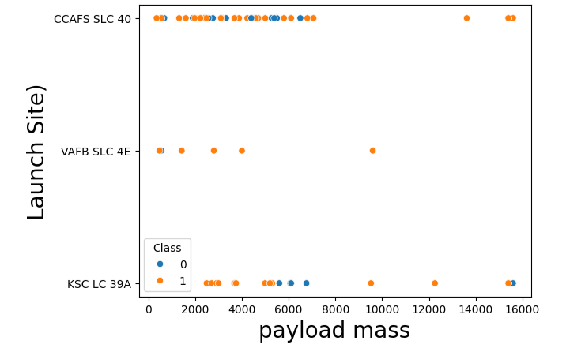
Payload vs. Launch Site
This plot shows how payload size varies across different launch sites.
The plot shows that even as payload increases, success rate increases too
KSC LC 39A had the highest success rate but also the least attempts
There is good success rate at launch site VAFB SCL 4E generally across all weights, more especially in the greater weights of 14000 kg and above.

Slide 26
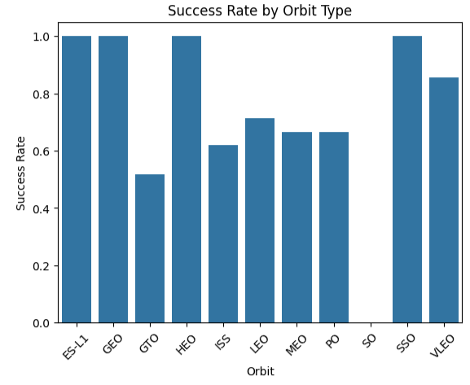
Success Rate vs. Orbit Type
The chart compares how often launches to different orbit types resulted in successful landings
There was No success rate recorded for the SO orbit and GTO had the lowest success rate
Most Orbits have a pretty good success rates ES –L11, GEO, HEO and SSO Orbits

Slide 27
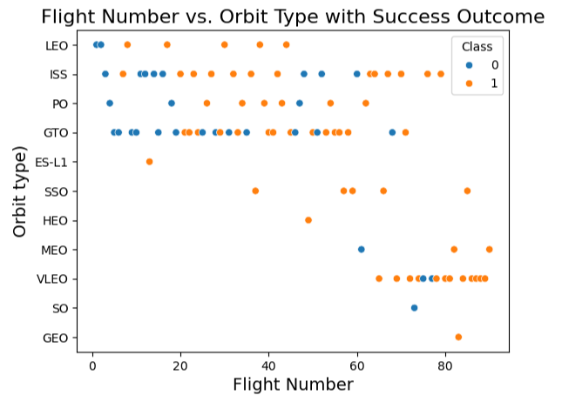
Flight Number vs. Orbit Type
This plot helps trace how SpaceX launched different orbit types over time
Colour by class shows great improvement in success rate across later flights

Slide 28
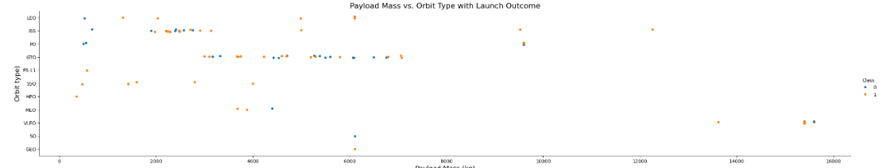
Payload vs. Orbit Type
Show a scatter point of payload vs. orbit type
Show the screenshot of the scatter plot with explanations

Slide 29
Payload vs. Orbit Type
The show the relationship berween Payload Mass and Orbit Type with Launch Outcome.
With heavy payloads the successful landing or positive landing rate are more for Polar,LEO and ISS
For GTO, it's difficult to distinguish between successful and unsuccessful landings as both outcomes are present.

Slide 30
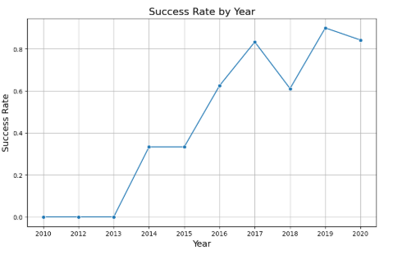
Launch Success Yearly Trend
The chart aggregates all launches per year and calculates the proportion of successful launches
The success rate increases steadily over time, reflecting improvements in reliability, technology, and experience. Example The success rate since 2013 kept increasing till 2020

Slide 31
All Launch Site Names
%sql SELECT distinct "Launch_Site" FROM SPACEXTABLE ;
OUTPUT
This query selects all the distinct (unique) entries from the “ Launch Site” in the SPACEXTABLE
The result shows four launch sites used by SpaceX across all the recorded missions
Launch Site
CCAFS LC-40
VAFB SLC-4E
KSC LC-39A
CCAFS SLC-40

Slide 32
Launch Site Names Begin with 'CCA'
%sql SELECT * FROM SPACEXTABLE WHERE "Launch_Site" LIKE 'CCA%' LIMIT 5;
Date | Time (UTC) | Booster_Version | Launch_Site | Payload | PAYLOAD_MASS__KG_ | Orbit | Customer | Mission_Outcome | Landing_Outcome
2010-06-04 | 18:45:00 | F9 v1.0 B0003 | CCAFS LC-40 | Dragon Spacecraft Qualification Unit | 0 | LEO | SpaceX | Success | Failure (parachute)
2010-12-08 | 15:43:00 | F9 v1.0 B0004 | CCAFS LC-40 | Dragon demo flight C1, two CubeSats, barrel of Brouere cheese | 0 | LEO (ISS) | NASA (COTS) NRO | Success | Failure (parachute)
2012-05-22 | 7:44:00 | F9 v1.0 B0005 | CCAFS LC-40 | Dragon demo flight C2 | 525 | LEO (ISS) | NASA (COTS) | Success | No attempt
2012-10-08 | 0:35:00 | F9 v1.0 B0006 | CCAFS LC-40 | SpaceX CRS-1 | 500 | LEO (ISS) | NASA (CRS) | Success | No attempt
2013-03-01 | 15:10:00 | F9 v1.0 B0007 | CCAFS LC-40 | SpaceX CRS-2 | 677 | LEO (ISS) | NASA (CRS) | Success | No attempt

Slide 33
Launch Site Names Begin with 'CCA
This query filters and retrieves records where the launch site name begins with “CCA”, indicating launches from Cape Canaveral Air Force Station (CCAFS). Using LIKE 'CCA%’ allows us to match all site names starting with "CCA". Only the first 5 matching records are shown using LIMIT 5 for brevity

Slide 34
Total Payload Mass
%%sql SELECT SUM("Payload_Mass__kg_")AS Total_Payload_Mass FROM SPACEXTABLE WHERE "Customer" = 'NASA (CRS)’;
OUTPUT
Note
Both %sql and %%sql are magic commands used with ipython-sql extension to run SQL queries within Jupyter notebooks.
Total_Payload_Mass
45596

Slide 35
Total Payload Mass
This query calculates the total payload mass (in kilograms) carried by all SpaceX launches involving NASA as a customer. The WHERE FILTERS only customer with "NASA" in their name.
The SUM() function adds up the payloads for those missions.

Slide 36
Average Payload Mass by F9 v1.1
%%sql SELECT AVG("Payload_Mass__kg_") FROM SPACEXTABLE WHERE "Booster_Version" = 'F9 v1.1’;
This query calculates the average payload mass (in kilograms) for all launches that used the F9 v1.1 booster version. The AVG() function computes the mean value of the "Payload Mass (kg)" column, filtered only for rows where "Booster Version" is 'F9 v1.1’
Note
Both %sql and %%sql are magic commands used with ipython-sql extension to run SQL queries within Jupyter notebooks.
AVG(Payload_Mass__kg_)
2928.4

Slide 37
First Successful Ground Landing Date
%%sql SELECT MIN(Date) FROM SPACEXTABLE WHERE "Landing_Outcome" = 'Success (ground pad)’;
SELECT MIN(Date): This finds the earliest date (the first occurrence) in the Date column FROM SPACEXTABLE: The query runs on the table named SPACEXTABLE, which holds your SpaceX launch data, WHERE "Landing_Outcome" = 'Success (ground pad)': This filters the rows to only those where the landing was successful and occurred on a ground pad.
The earliest successful landing on a ground pad was on 2015-12-22.
MIN(Date)
2015-12-22

Slide 38
Successful Drone Ship Landing with Payload between 4000 and 6000
%%sql SELECT "Booster_Version“ FROM SPACEXTABLE WHERE "Landing_Outcome" = 'Success (drone ship)’ AND "Payload_Mass__kg_" > 4000 AND "Payload_Mass__kg_" < 6000;
OUTCOME
Booster_Version
F9 FT B1022
F9 FT B1026
F9 FT B1021.2
F9 FT B1031.2

Slide 39
Successful Drone Ship Landing with Payload between 4000 and 6000
.SELECT "Booster_Version":This tells the database to retrieve only the Booster Version column from the result.
FROM SPACEXTABLE:This specifies the data table we are querying from SPACEXTABLE.
WHERE "Landing_Outcome" = 'Success (drone ship)':This filters the data to include only rows where the landing outcome was a successful drone ship landing.
AND "Payload_Mass__kg_" > 4000:Further filters to include only those rows where the payload mass was greater than 4000 kg.
AND "Payload_Mass__kg_" < 6000:And also less than 6000 kg, so we’re looking for boosters that carried a moderate-heavy payload.

Slide 40
Total Number of Successful and Failure Mission Outcomes
%%sql SELECT "Mission_Outcome", COUNT(*) AS Total FROM SPACEXTABLE GROUP BY "Mission_Outcome";
Mission_Outcome | Total
Failure (in flight) | 1
Success | 98
Success | 1
Success (payload status unclear) | 1

Slide 41
Total Number of Successful and Failure Mission Outcomes
%%sql:Magic command in Jupyter to run SQL in the cell.
SELECT "Mission_Outcome", COUNT(*) AS Total:This selects each unique mission outcome and counts how many times it appears.
COUNT(*) counts all rows for each outcome and labels the count as Total.
FROM SPACEXTABLE:This specifies the source table you’re querying from.
GROUP BY "Mission_Outcome":This groups all records with the same mission outcome, so the COUNT(*) applies to each group.

Slide 42
Boosters Carried Maximum Payload
%%sql SELECT "Booster_Version“ FROM SPACEXTABLE WHERE "Payload_Mass__kg_" = (SELECT MAX("Payload_Mass__kg_") FROM SPACEXTABLE);
OUTCOME
Booster_Version
F9 B5 B1048.4
F9 B5 B1049.4
F9 B5 B1051.3
F9 B5 B1056.4
F9 B5 B1048.5
F9 B5 B1051.4
F9 B5 B1049.5
F9 B5 B1060.2
F9 B5 B1058.3
F9 B5 B1051.6
F9 B5 B1060.3
F9 B5 B1049.7

Slide 43
Boosters Carried Maximum Payload
%%sql: Tells the notebook to run the cell as an SQL query.
SELECT "Booster_Version": This retrieves the name(s) of the booster version.
FROM SPACEXTABLE: Specifies the table to query from.WHERE "Payload_Mass__kg_" = (...): Filters the rows to only those where the payload mass is equal to the maximum value.
SELECT MAX("Payload_Mass__kg_") FROM SPACEXTABLE: This inner query gets the largest payload mass in the entire table.

Slide 44
2015 Launch Records
%%sql SELECT SUBSTR(Date, 6, 2) AS Month, "Landing_Outcome", "Booster_Version", "Launch_Site“ FROM SPACEXTABLE WHERE "Landing_Outcome" LIKE '%Failure%' AND "Landing_Outcome" LIKE '%drone ship%' AND SUBSTR(Date, 0, 5) = '2015’;
Month | Landing_Outcome | Booster_Version | Launch_Site
01 | Failure (drone ship) | F9 v1.1 B1012 | CCAFS LC-40
04 | Failure (drone ship) | F9 v1.1 B1015 | CCAFS LC-40

Slide 45
2015 Launch Records
SUBSTR(Date, 6, 2) AS Month:Extracts the month (characters 6 and 7) from the Date column. This returns values like '01', '02’, .
"Landing_Outcome" LIKE '%Failure%':Filters records that include the word "Failure" in the landing outcome ( "Failure (drone ship)").
"Landing_Outcome" LIKE '%drone ship%':Further filters to include only failures specifically on a drone ship.
SUBSTR(Date, 0, 5) = '2015':Filters for launches that occurred in the year 2015.
SELECT ... FROM SPACEXTABLE:Retrieves relevant columns from the table after all the above filters.

Slide 46
Rank Landing Outcomes Between 2010-06-04 and 2017-03-20
%%sql SELECT "Landing_Outcome", COUNT(*) AS Outcome_Count FROM SPACEXTABLE WHERE Date BETWEEN '2010-06-04' AND '2017-03-20’ GROUP BY "Landing_Outcome“ ORDER BY Outcome_Count DESC;
OUTCOME
Landing_Outcome | Outcome_Count
No attempt | 10
Success (drone ship) | 5
Failure (drone ship) | 5
Success (ground pad) | 3
Controlled (ocean) | 3
Uncontrolled (ocean) | 2
Failure (parachute) | 2
Precluded (drone ship) | 1

Slide 47
Rank Landing Outcomes Between 2010-06-04 and 2017-03-20
This query analyzed all SpaceX landings between June 2010 and March 2017. It grouped the landings by outcome type and counted how often each occurred. Results were sorted to highlight the most common outcomes, helping identify which landing methods were most successful or problematic

Slide 48

Section 3

Slide 49
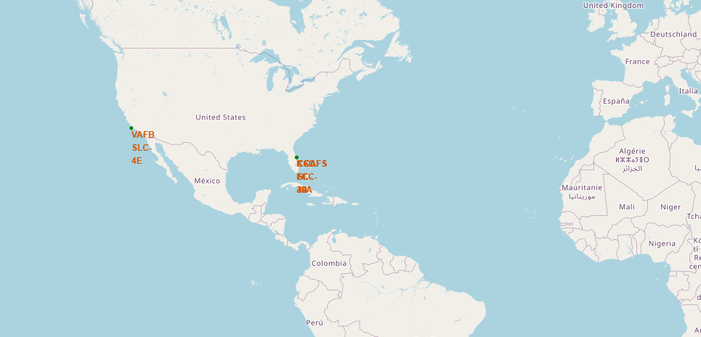
<Folium Map of NASA Launch Sites >

Slide 50
<Folium Map of NASA Launch Sites >
All the NASA Lauch Sites are located either on the east coast or west coast of the united states
Popups or icons give site-specific information when clicked.
This visualization helps identify strategic launch positions based on coastlines and space center locations.

Slide 51
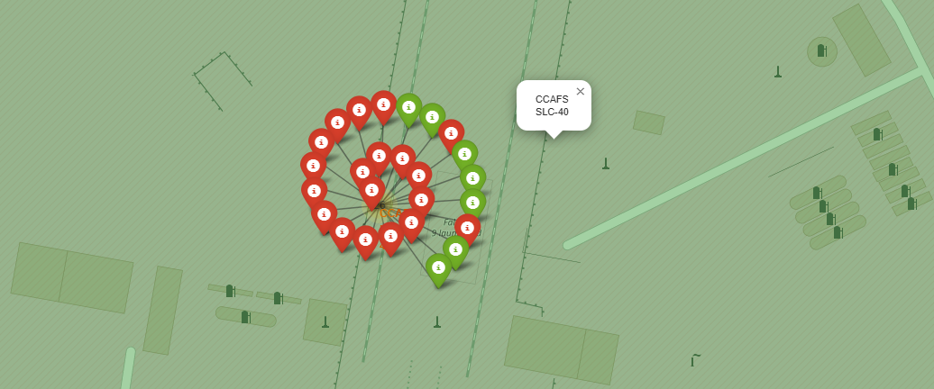
<Map of colour labeled Launch outcome>

Slide 52
Map of colour labeled Launch outcome
This map uses colored circle markers to represent different launch outcomes at each site.
Green markers indicate successful landings, while red shows failures, helping visualize SpaceX’s performance over time and by location.

Slide 53
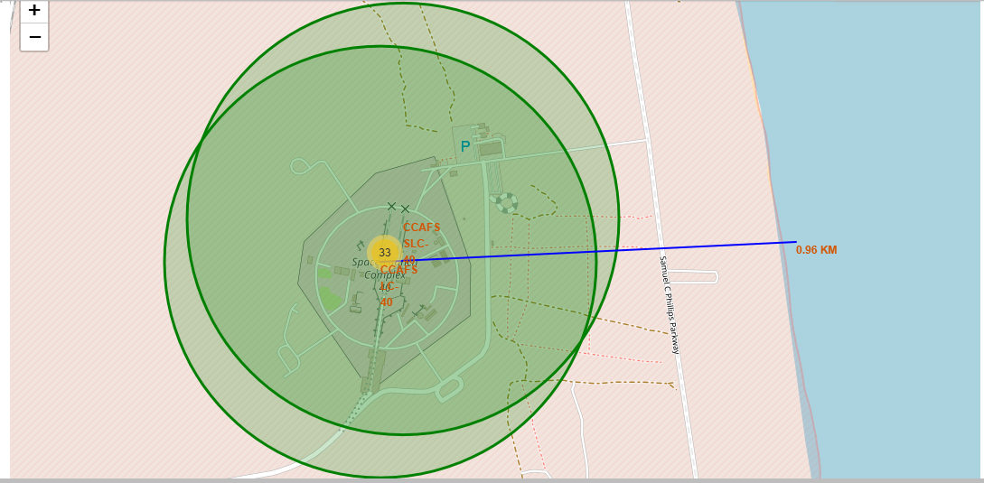
<"Launch Site Proximity Analysis with Distance Marker Coastline">

Slide 54
<"Launch Site Proximity Analysis with Distance Marker Coastline">
This screenshot highlights the geographic context of a launch site in relation to nearby coastline.
The coastline is approximately 0.96 km away from the CCAFS LC 40 launch site

Slide 55

Section 4

Slide 56
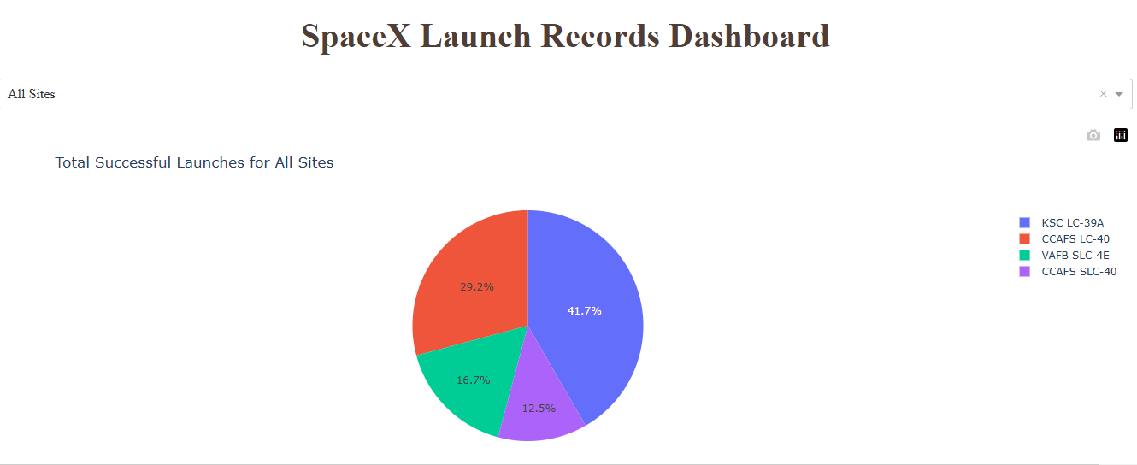
<TOTAL SUCCESSFUL LAUNCHES FOR ALL SITES >

Slide 57
<TOTAL SUCCESSFUL LAUNCHES FOR ALL SITES >
Majority of the successful launches were at KSC LC 3A Launch Site with 41.7% of the total successful.
The rest o the successful launches are relatively distributed among the other sites

Slide 58
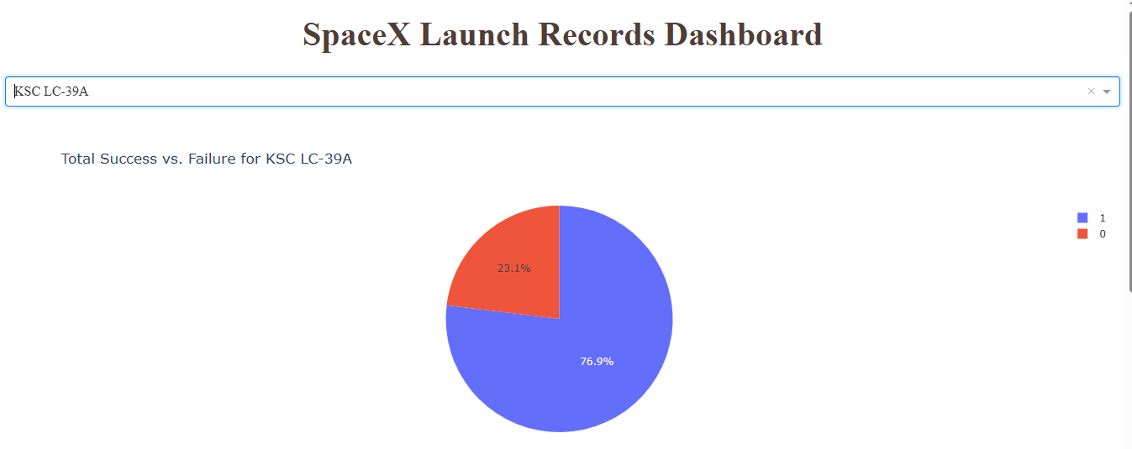
<Launch Site with Highest success ratio>

Slide 59
<Launch Site with Highest success ratio>
The KSC LC 3A Launch Site yet have the highest success ratio, with over three quarters of launches been successful, precisely 76.9 of launches being successful.

Slide 60
<Payload vs. Launch Outcome >
FROM BELOW SCREENSHOTS OF SCATTER PLOTS OF PAYLOADS VRS OUTCOMES IT IS OBSERVED THAT
No clear correlation with launch site, suggesting booster version and payload tuning are more influential on success rate.

Slide 61
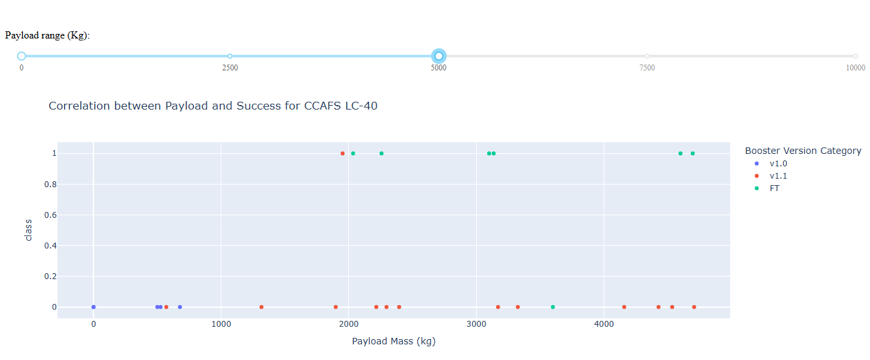
Payload vrs success outcome of CCAFS LC -40

Slide 62
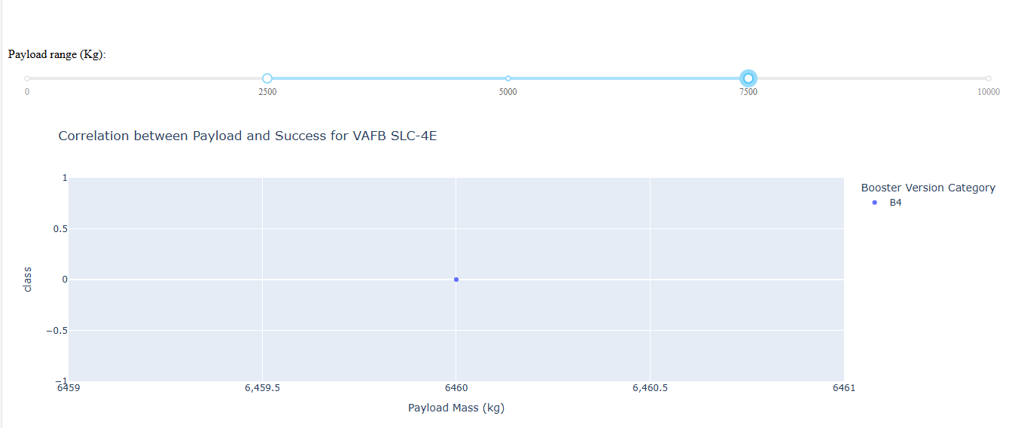
Payload vrs success outcome of VAFB SLC -4E

Slide 63
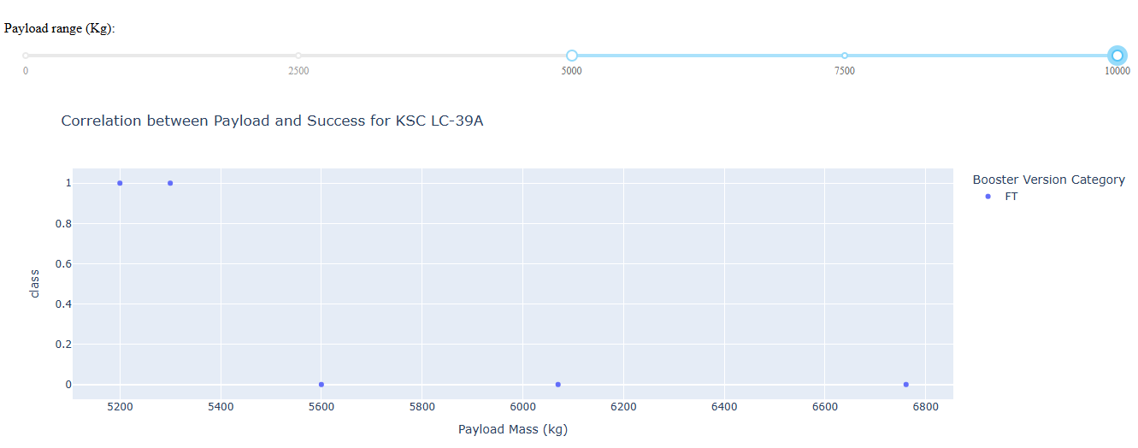
Payload vrs success outcome of KSC LC -39A

Slide 64

Section 5

Slide 65
Classification Accuracy
accuracies = { "Logistic Regression": logreg_cv.best_score_, "Support Vector Machine": svm_cv.best_score_, "Decision Tree": tree_cv.best_score_, "K-Nearest Neighbors": knn_cv.best_score_}best_model = max(accuracies, key=accuracies.get)best_accuracy = accuracies[best_model]print(f"The best performing model is {best_model} with an accuracy of {best_accuracy:.4f}")
OUTCOME
The best performing model is Decision Tree with an accuracy of 0.8750

Slide 66
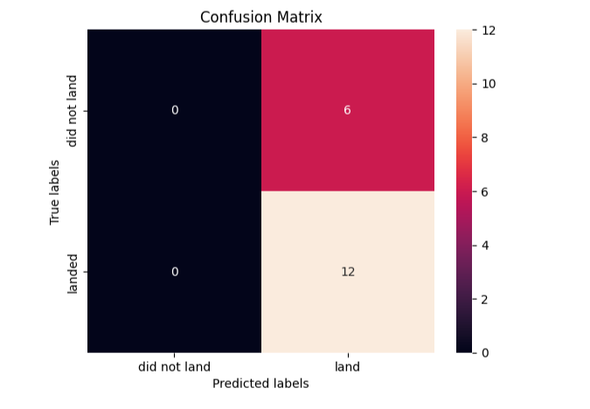
Confusion Matrix

Slide 67
Confusion Matrix- Best performing Model Decision Tree
True Positives (TP) = 12 — The model correctly predicted 12 actual successes.
False Positives (FP) = 6 — The model incorrectly predicted success for 6 failures.
True Negatives (TN) = 0 — The model never correctly predicted a failure.
False Negatives (FN) = 0 — The model never missed a successful launch.

Slide 68
Conclusions
End-to-End Data Science Pipeline Completed: We successfully followed a full data science workflow—from data collection (via SpaceX API and web scraping) through data wrangling, exploratory analysis, interactive visualization, and predictive modeling.
Data Insights via EDA and Dashboards:Through SQL queries, visualization, and Folium/Plotly Dash dashboards, we uncovered valuable insights, such as the influence of payload mass, launch site, and orbit type on mission success.
Several classification models were used with decision tree appearing to have the best accuracies.
Real-World Application Demonstrated: This capstone project showcased how data science can inform strategic decision-making in the aerospace sector—highlighting launch patterns, risk factors, and performance metrics to optimize future missions

Slide 69
Appendix
Include any relevant assets like Python code snippets, SQL queries, charts, Notebook outputs, or data sets that you may have created during this project

Slide 70


